Slide 1

AREA SHOOTER

Slide 2
AREA SHOOTER
AREA PLAN HELPER
BEYOND AEC HACKATHON 2018
Matt Mason - Imaginit
Chris Mungenast - Elkus Manfredi
Jess Purcell - Shepley Bulfinch
Thank you Sponsers and Volunteers!!

Slide 3
AREA PLAN HELPER
TEXT

Slide 4
AREA PLAN HELPER
Not a perfect thing, but create 80% good Area Plans
Takes Rooms and creates areas to match (not always what one wants)
Rooms hold Area Category Values
Numerical score applied to Area Category by ranking system
Area separation lines drawn to correct side of wall based on score of rooms
On each side of a given wall.

Slide 5
AREA PLAN HELPER
Revit Model Assumptions:
Arch files have rooms in all spaces enclosed by walls (incl. shafts)
Rooms have custom ‘Area_Category’ parameter values
Exterior wall types need ‘Function’ set to ‘Exterior’
Area Plans are built in a separate Revit file with arch files linked in.
(also functions if area plans are in same arch file)
Area Plan file should have level names and heights corresponding
to the linked files (might add function to copy/coordinate levels)
and should have ‘Area_Ranking’ and ‘Area_Category’ for Rooms and Areas

Slide 6
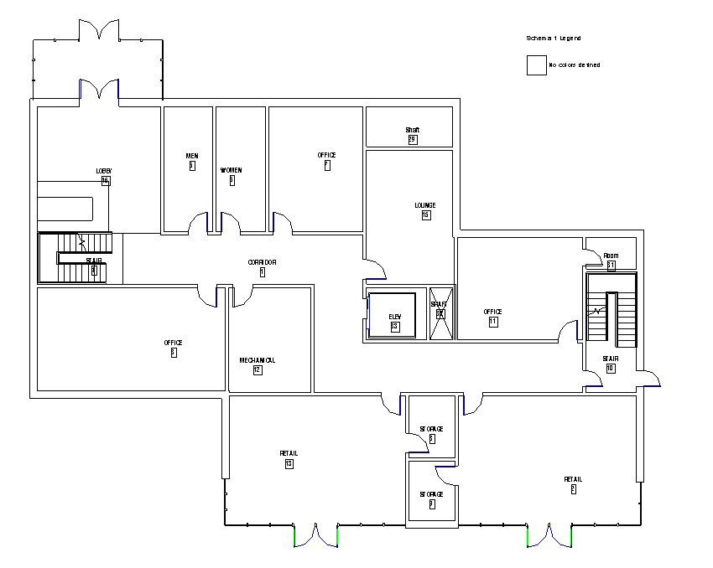
AREA PLAN HELPER
TEXT

Slide 7
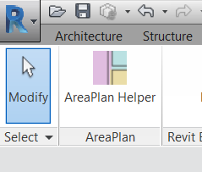
AREA PLAN HELPER
TEXT

Slide 8
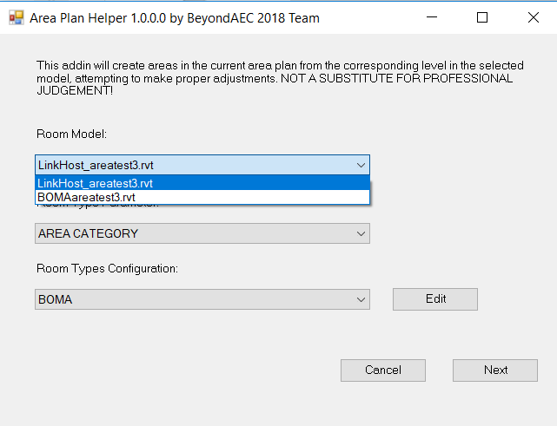
AREA PLAN HELPER
TEXT

Slide 9
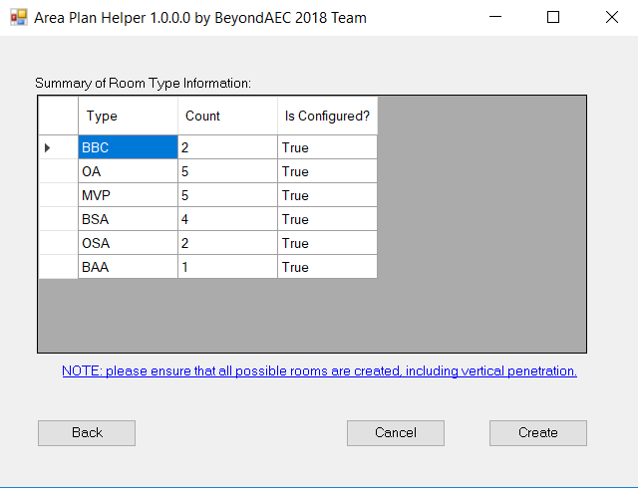
AREA PLAN HELPER
TEXT

Slide 10
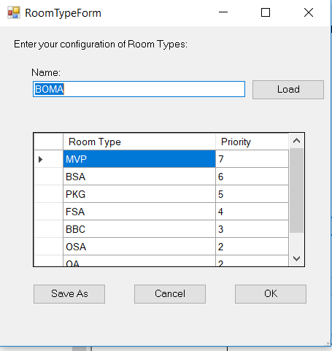
AREA PLAN HELPER
TEXT

Slide 11
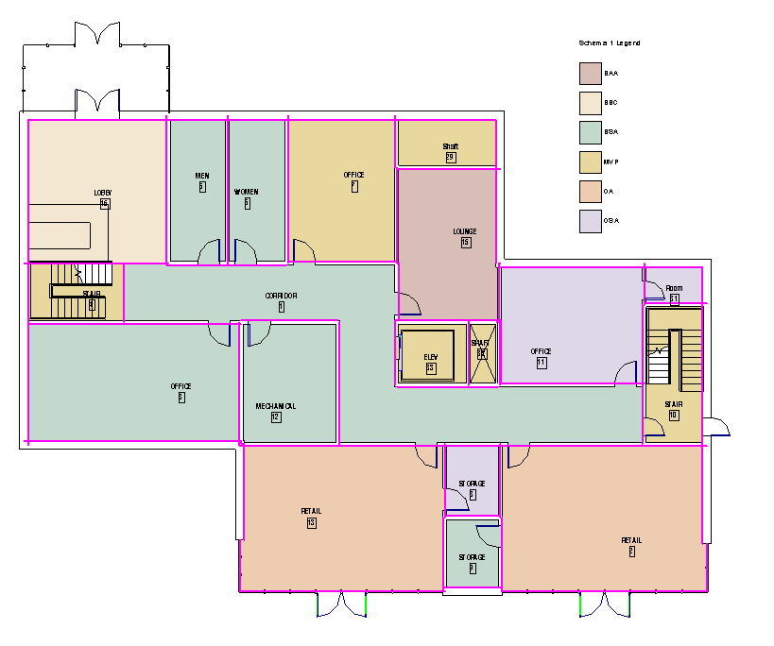
AREA PLAN HELPER
TEXT

Slide 12
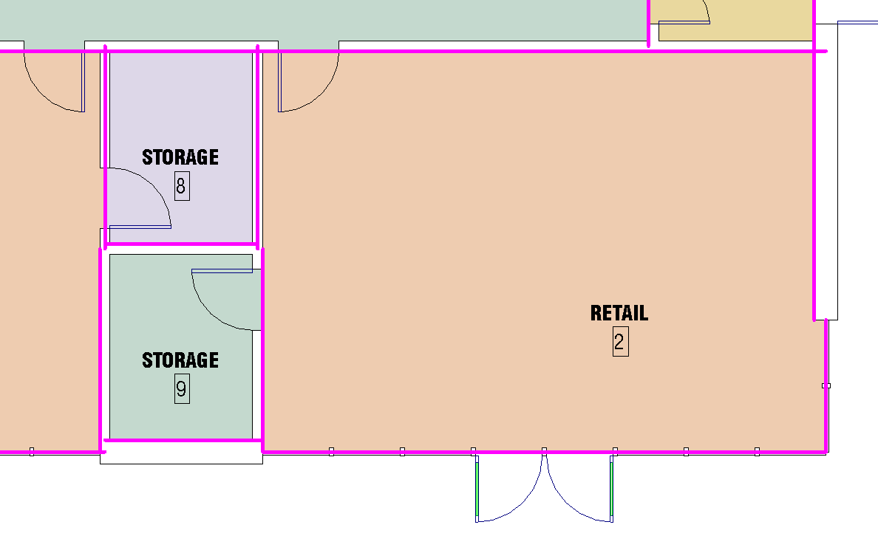
AREA PLAN HELPER
TEXT

Slide 13
AREA PLAN HELPER
From Area Plan, user starts ‘Area Plan Helper’
Gets Rooms from Linked file(s) from the same level and Phase (as well as shaft Rooms with lower level and height that would Intersect with the current level)
Collect Room’s location, name, and ‘Area_Category’
Assign ‘Area_Ranking’ based on hierarchy of ‘Area_Category’
If Room name contains letters ‘Corr’, discard.
else Get Room edges and corresponding bounding elements
If bounding element is ‘Column’, discard.
else Get each wall’s centerline, midpoint, function, and thickness
If function = Exterior
if type = Curtainwall, use location line to create A.S. Line
else use inside face of wall
(user is going to have to do some manual work to locate dominant surface)
function /= Exterior, draw test lines from segment midpoint perp in/out
Find neighboring Room at this location and compare ‘Area_Ranking’
if ranking is =, draw R.S.L at wall centerline
if ranking is <, draw R.S.L
Create Areas using Room’s location, name, and ‘Area_Category’

Slide 14
AREA PLAN HELPER
TEXT

Slide 15
AREA PLAN HELPER
TEXT

Slide 16
AREA PLAN HELPER
TEXT

